Slide 1



What are those functions doing ?
canvas.move(ball,5,5)
canvas.coords()
canvas.moveTo(ball,5,5)
canvas. itemconfig()
canvas.after(50, lambda:moveBall())

Slide 2

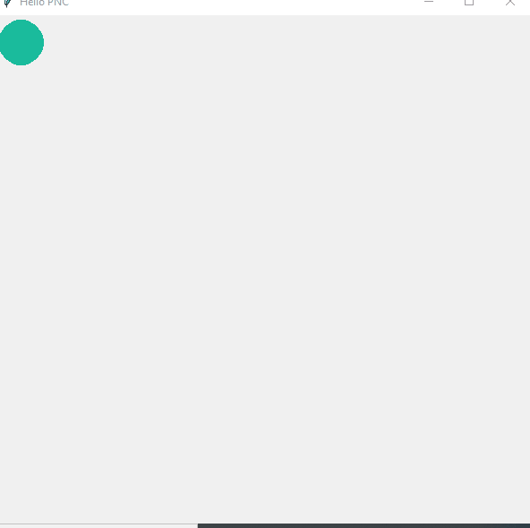
Exercise 1
Use canvas.move and canvas.after to put animation in your window and move a circle
Tip: use the same structure of the previous exercise
Notes:
Give the tip to do

Slide 3

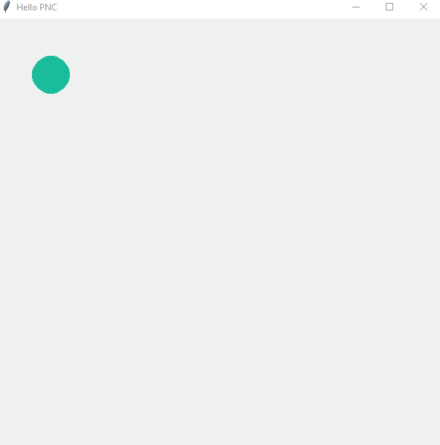
Exercise 2
Make it rebound infinetly

Slide 4
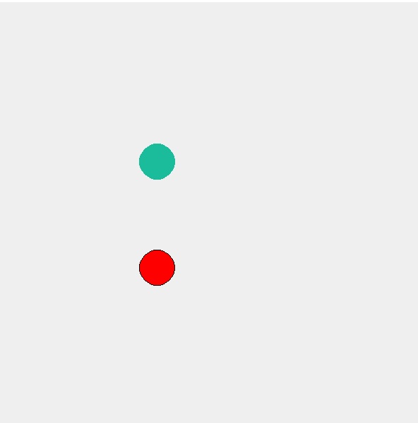
Exercise 3
Move two balls

Slide 5
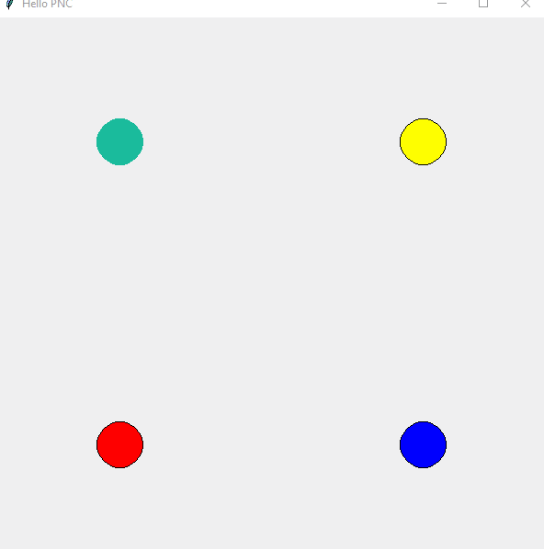
Exercise 4
Use a list and a loop to move 4 balls simultanely in your window

Slide 6
Exercise 5
Move a ball on your window, and make it change directions when you click on your keyboard (up, down, left, right

Slide 7
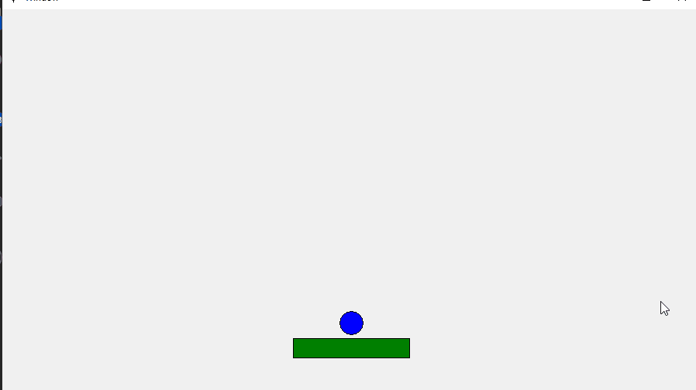
Exercise 6
13
Code a Pong game

